Slide 1
Cell Observatory Users Meeting ESS Guidelines and Immediate Required Action Items

Slide 2
Aims
Cell Observatory Data Storage Overview
ESS Usage Guidelines – Active from tomorrow
Required Immediate Action
1st step By February 8th
2nd step by February 26th

Slide 3
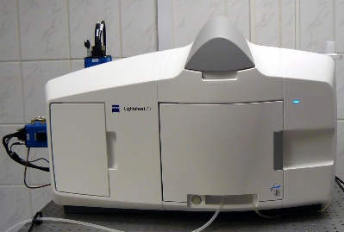
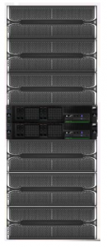
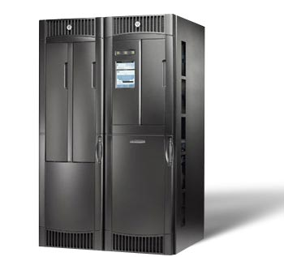
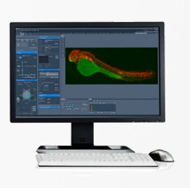
Cell Observatory Data Storage Overview
ESS: ~430Tb Active Storage
Long Term Data Archive
Almost Full
Very Messy
Currently ~800TB * 2 !
Will be Charged Soon
Automatically saved during Acquisition
Inspect and Manual Move To Raw_Data
Automatically Archive All Data from Raw_Data & Analyzed_Data
Recovery of Archived Data
Z1 Storage PC aka SWAP
Visualize / Analyze directly from ESS (GPFS protocol over fast network)
Create new Data on Temp & Analyzed_Data

Slide 4
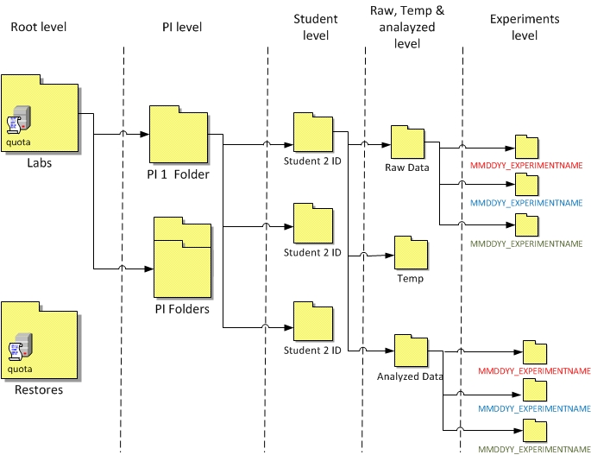
ESS Folder Structure
Notes:
Important:
Use subfolders with meaningful names
Don’t use special characters and space in subfolders/file names
Don’t save data out of subfolders

Slide 5
My ESS Disk Usage
Use TreeSize Free to inspect your ESS disk Usage

Slide 6
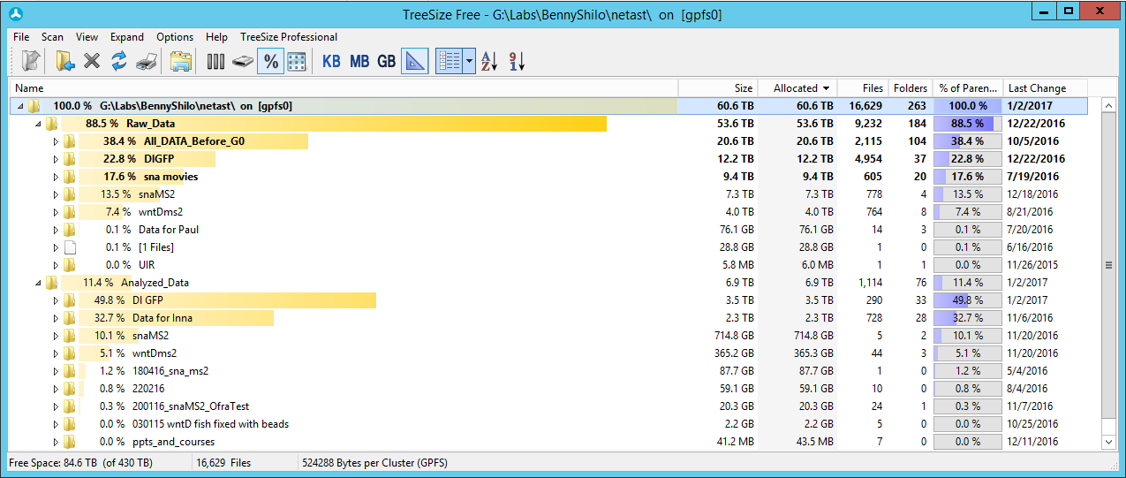
My ESS Disk Usage
Use TreeSize Free to inspect your ESS disk Usage

Slide 7
Typical Workflow: Data Duplication Problem
Data Acquisition
ZEN
Dual Side Fusion
ZEN / Fiji SPIM Registration
Multi-View Fusion
ZEN / Fiji SPIM Registration
MV-Fused file .czi
Fused file .czi
Original File .czi
Load into Arivis
Arivis
Non-stitched Arivis file .sis
Stitching
Arivis / Fiji / TeraStitcher
Stitched Arivis File .sis
Export
Arivis
.tif files
Analyze
Imaris
Imaris file .ims
Delete after Fusion
Delete After Stitching
Delete After Import to Imaris

Slide 8
ESS Usage Guidelines
Follow File and folder naming guidelines (meaningful name, no spaces, no special characters, don’t save files directly under Raw/Analyzed/Temp)
Raw Data should be always archived
Never Duplicate Raw Data files on ESS (Under Raw_Data folder, or different user)
Minimize (Saving of) Data Duplicates
Dual Side Fusion and Multi-View Fusion (using ZEN) will be saved under Raw_Data All Further Data Visualization & Analysis should be done in the user’s Temp folder
Carefully Select which Analyzed data to archive, move it to Analyzed_Data (Don’t copy) – Charging will be based on size of archived data
Use Matched Folders Names in Raw_Data / Analyzed_Data / Temp
Quota / Time policy will be imposed
Active for new data from Jan 24th

Slide 9
Data Archive & Retrieval
Data will not be saved on ESS forever
All Data is stored on 2 copies
Raw and Processed Archived Data can be recovered from the Tapes
Note that any change to a file create another archived copy (analyzed data) Archived data will be charged by TB
In order to retrieve files from the Tapes a full path should be provided
To enable data retrieval a database application will be created
Retrieval is into Restore folder
Full Data Retrieval Instructions will be posted soon

Slide 10
Data Archive & Retrieval
Data will not be saved on ESS forever
All Data is stored on 2 copies
Raw and Processed Archived Data can be recovered from the Tapes
Note that any change to a file create another archived copy (relevant for analyzed data). Old versions are saved for 30 days <<we need to verify this>>
Archived data will be charged by TB
In order to retrieve files from the Tapes a full path should be provided
To enable data retrieval a database application will be created
Retrieval is into Restore folder
Restored files should be moved by the user into exactly the same location they used to be. << This will make them new files and will cause a new backup ? >>
Full Data Retrieval Instructions will be posted soon

Slide 11
Data Annotation
Storing the information about the datasets names and content is required to enable data retrieval
A database application will help you keep track of your files and experiments.
Impossible to save information at the single file level (optionally multiple files for experiment)
Path and description will be saved at the folder level only and not at the single file level
A new item will be added for each subfolder that contain data files
Automatically saved info: Folder name, Full path, Folder creation date, Number of files, size, Data ownership
The user is required to fill in additional information:
Experiment information (textual): conditions, date , number of files of each experiment
Anything that you think you or your PI will need 2 years from now to identify the experiment
Base File names, multiple files separated by comma
Full Data Annotation Instructions will be posted soon
Notes:
A new item will be added for each subfolder that contain data files (immediate folder above individual files)
number of files (time-points/FOV) of each experiment

Slide 12
Data Annotation
Storing the information about the datasets names and content is required to enable data retrieval
A database application will help you keep track of your files and experiments.
Impossible to save information at the single file level (optionally multiple files for experiment)
Path and description will be saved at the folder level only and not at the single file level
A new item will be added for each subfolder that contain data files (immediate folder above individual files)
Automatically saved info: Folder name, Full path, Folder creation date, Number of files, size, Data ownership
You are required to fill in additional needed information
Experiment information (textual): conditions, date , number of files (time-points/FOV) of each experiment
Anything that you think you or your PI will need 2 years from now to identify the experiment
Base File names, multiple files separated by comma
Full Data Annotation Instructions will be posted soon
Notes:
A new item will be added for each subfolder that contain data files (immediate folder above individual files)

Slide 13
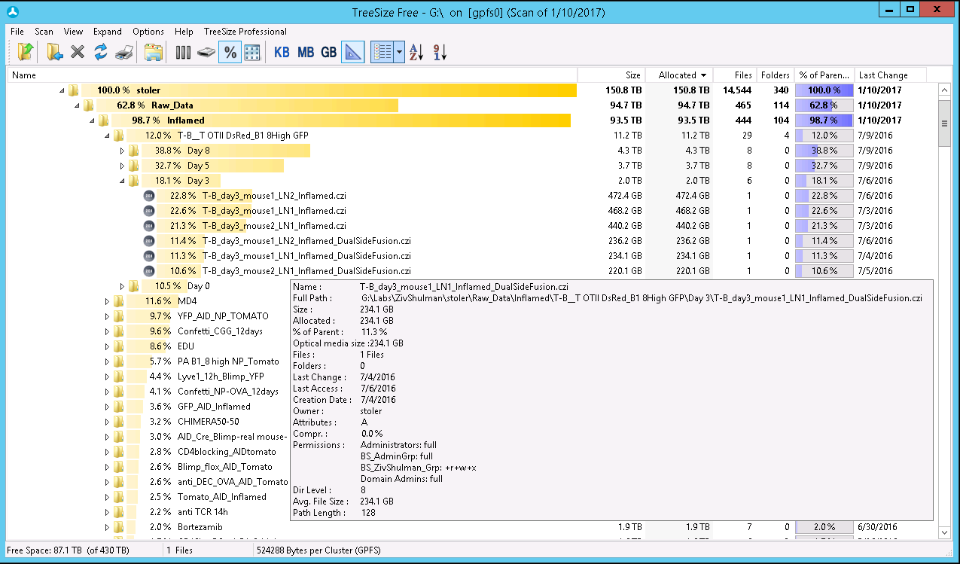
Nested Folders, Single File per Experiment
Notes:
Important:
Use subfolders with meaningful names
Don’t use special characters and space in subfolders/file names
Don’t save data out of subfolders

Slide 14
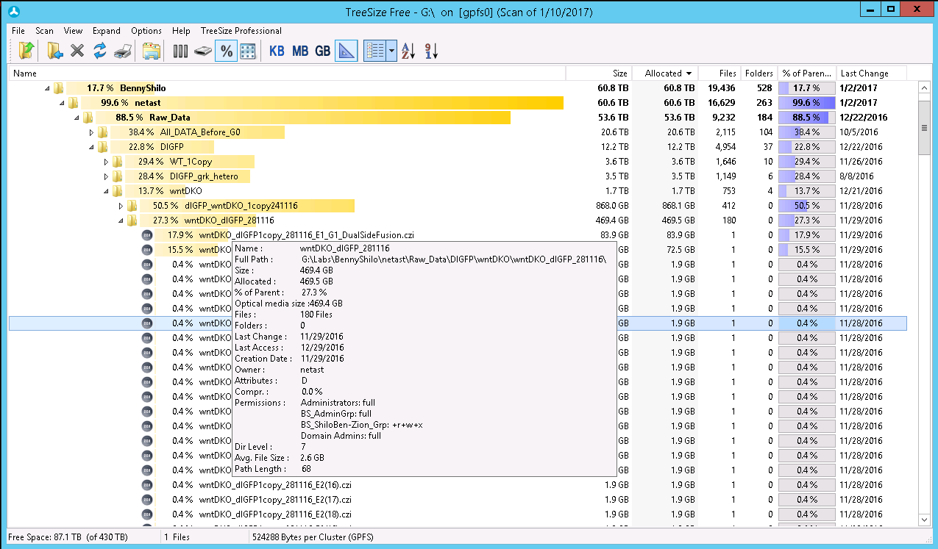
Nested Folders, Multiple Files per Experiment
Notes:
Important:
Use subfolders with meaningful names
Don’t use special characters and space in subfolders/file names
Don’t save data out of subfolders

Slide 15
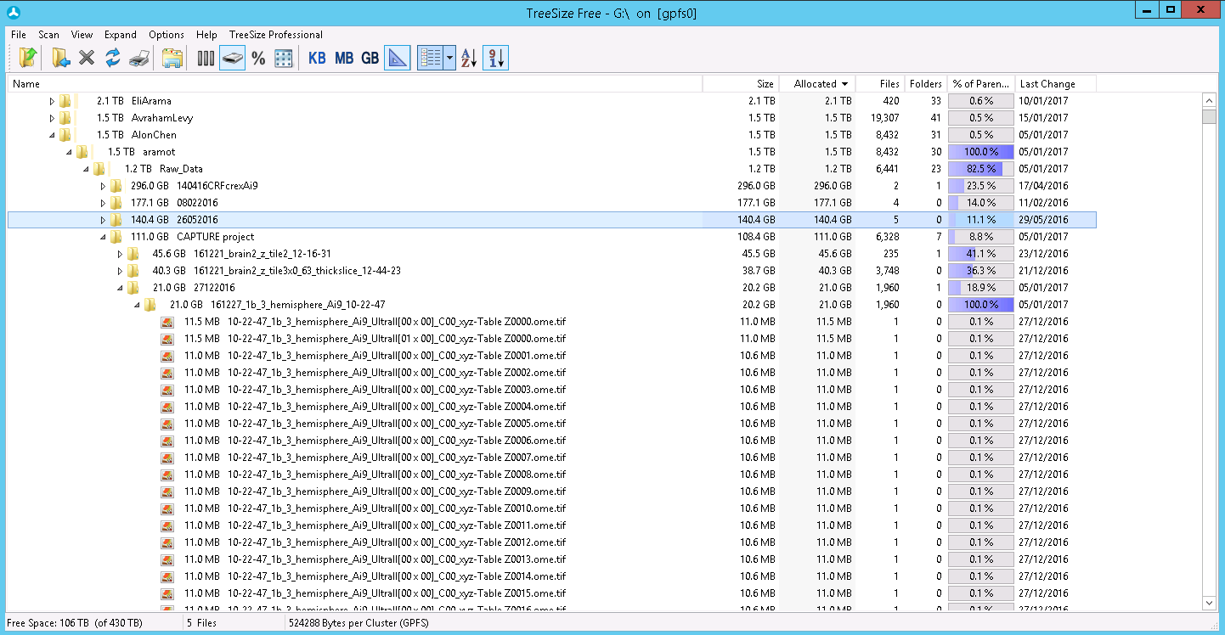
Nested Folders, Multiple Files per Experiment
Notes:
Important:
Use subfolders with meaningful names
Don’t use special characters and space in subfolders/file names
Don’t save data out of subfolders

Slide 16
ESS Reorganization & Cleanup
Required Action Step 1: by February 8
- Delete all data that is
1. Not needed (bad experiment, temporary)
2. No need to archive it
Reorganize the data
Create updated fresh archive
Required Action Step 2: TBA, tentatively by February 26
- Annotate data to enable retrieval
- Delete data that is not needed currently (once archived)

Slide 17
Required Action Step 1: By February 8
Delete unsuccessful experiments
From all folders
Remove Duplicated Data Step1
For all files stitched in Arivis – Delete the non-stitched Arivis files
Delete all temporary tif files (exported from Arivis for import in Imaris)
Remove all other un-needed data (eg. Duplicated files) from ESS and from WS
Reorganize Data
Match folders names under Raw_Data / Analyzed_Data / Temp
Move analyzed data that you do not want to archive into Temp folder

Slide 18
Required Action Step 2: TBA By February 26
Annotate Data to enable Data Retrieval
We are currently building an application for this, more instructions will be posted soon
Remove Duplicated Data step 2
For all files for which Dual-Side Fusion was done successfully – Delete the original files (before fusion)
Remove all other un-needed data (eg. Duplicated files)

Slide 19
Remote Data Access and Further Info
Connecting to the ESS from your lab
Open my computer → Map network drive → Folder → \\analyis80t.wismain.weizmann.ac.il\Labs\lab_name
At security prompt enter:
username - wismain\userID
password - your WIS regular password
Further info can be found on the Unit WIKI page:
https://bbcunit.atlassian.net/wiki/display/BIMGP/Advanced+Light+Microscopy+Unit

